Slide 1
Capstone 2:
Final Presentation (non-technical)
27 March 2022

Slide 2
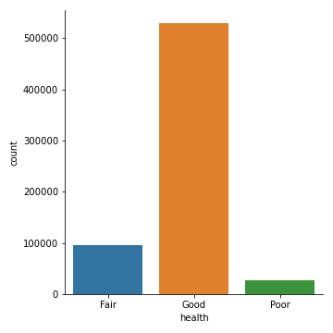
New York City Public Trees
Over 684k+ trees
Vast majority of trees in ‘good’ health
Question:
How can the NYC Parks and Recreations department allocate the municipal budget for tree maintenance?

Slide 3
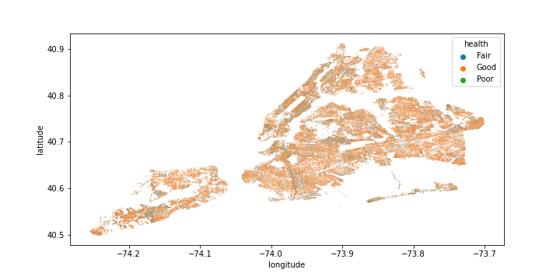
Answer: Focus on trees in ‘fair’ and ‘poor’ health
Challenge:
Trees with ‘fair’ and ‘poor’ health are distributed throughout the city
Question:
How can the department plan its tree maintenance without checking every tree every year?

Slide 4
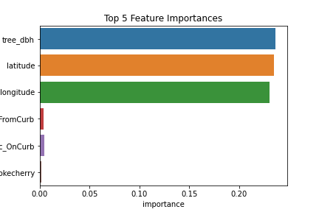
Answer: Predict the health of trees annually
2015 Street Tree Census conducted by volunteers and staff
Use past data to predict the future health status of trees
Solution:
Decision Tree Classifier

Slide 5
Predictions: 75% Accuracy
The Decision Tree Classifier predicts tree health
The NYC Parks and Recreations department can focus on areas that will have highest density of trees with ‘fair’ and ‘poor’ health
Municipal budget is maximized each year

